Slide 1
DevOps

Slide 2
Outline
DevOps Intro
DevOps & Agile
Continuous Integration
Continuous Delivery
Continuous Deployment
DevOps Tools - Sonar

Slide 3
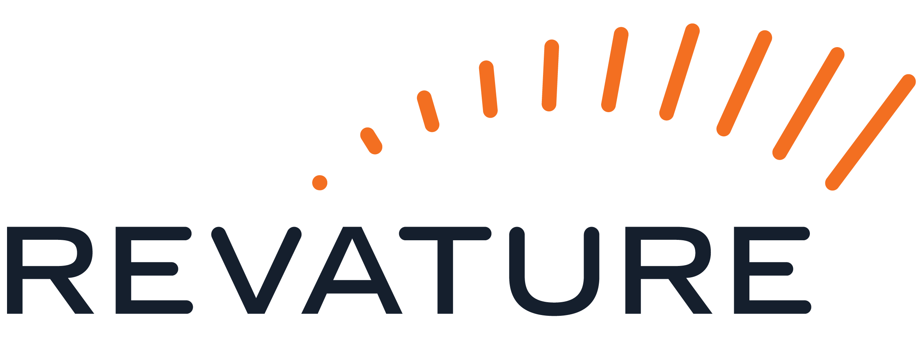
DevOps Intro

Slide 4
DevOps
Software Development Operations are a set of practices and methodologies designed to combine the development, deployment and maintenance of code into a streamlined process.
Development: Production/writing of code
Deployment: Making code available in a production environment (typically cloud)
Maintenance: Ongoing updates/bug fixing of codebase & application as a whole.
The primary goal of DevOps is to expedite the lifecycle of application development, particularly through the automation of tasks

Slide 5
DevOps
The steps or phases for DevOps refers to the creation, testing and deployment of an application
Source Code Control: Producing (writing) code and pushing to a repository
Building and Testing Automation: Test basic functionality of code (generally unit testing) and create a new, working build
Deployment to Staging: Deployment of working build to a temporary environment
Acceptance Testing: Undergo other more complex tests (systems, integration, UAT), with the temporary environment
Deployment of Build: Migrate working build to Production environment accessible by end users.

Slide 6
DevOps & Agile

Slide 7
DevOps & Agile
Agile is a mentality or philosophy utilized when approaching the creation of IT / Software systems and is a flexible approach of addressing the steps of SDLC (software development lifecycle)
Development teams who practice an Agile methodology place a focus on producing code through iteration and collaboration rather than following a rigid plan.
Though DevOps, which involves the creation of a systematic approach to producing code, and Agile, which is a mentality that focuses on creating products by adapting to change quickly, seem contradictory – the goal of both methodologies is to produce working and valuable products more efficiently
DevOps pertains to the entire system working together to produce, test, deploy and maintain the code base, while Agile practices allow for each step of that process to change wherever and whenever needed.

Slide 8
DevOps & Agile
Generally, there are three ways of approaching a DevOps culture with an Agile methodology
System Thinking: Placing emphasis on the performance of an entire system
Amplify Feedback Loops: Through the use of automation, the speed and efficiency of feedback loops can drastically improve
Culture of Continual Experimentation and Learning: Fostering a work culture which values taking risks and learning from failure – knowing that this understanding, practice and repetition are the prerequisites to mastery.
This can lead to increased collaboration and self-reflection and promotes further improvement for an entire workplace community

Slide 9
DevOps & Agile
The adoption of the Agile philosophies can provide a stepping stone for the establishment of a working DevOps pipeline, since Agile practices intrinsically produce more continuous feedback loops
Agile Practices with DevOps:
Continuous Integration
Continuous Delivery
Continuous Deployment

Slide 10
Continuous Integration

Slide 11
Continuous Integration
Continuous Integration (CI) is the first, and most fundamental step in creating an autonomous development pipeline.
Similarly, to Continuous Delivery and Continuous Deployment, Continuous Integration is a development Team mentality and is achieved when all members of the development team practice consistent merging of code into a central repository.
For CI to take place, these central repositories should be in the form of version control software (Git)
Version control tools track changes to code, and allow changes to be merged (allowing you to select what changes to keep/reject if, and when, conflicts arise).
Version Control tools also allow files to be rolled back to a previous version
Integration of code into these repositories should happen as often as possible, with at least one commit each day (often more)

Slide 12
Continuous Integration | Benefits
Ensures the entire team works on the most up to date code
Frequently pushing code allows developers to account for changes performed by other team members quickly.
Detects broken builds quickly
If problems arise, version control software can help detect the root cause or rollback changes when necessary
Code Can be tested easily by creating separate test or development branches based on the mainline code
Reduces risk in development when a large codebase has already been established
Reduces the overall number of bugs in a project

Slide 13
Continuous Delivery

Slide 14
Continuous Delivery
Continuous Delivery is a paradigm in which the building, management and testing of produced software is automated such that deployments can be performed at the push of a button
Continuous Delivery is often confused with Continuous deployment, which automates the entire production pipeline
Continuous delivery is the process of automating all steps of a development pipeline except for the final deployment step
Inherently, Continuous delivery is dependent on the implementation of continuous integration, and also serves as a stepping stone to creating a fully automated Development Pipeline (Continuous Deployment)

Slide 15
Continuous Delivery
Though CI can technically be achieved without automation, Continuous Delivery is only achieved when code integration, testing and product building has been automated
In this way, you are able to perform frequent deployments “at the press of a button”, but may choose not to do so, usually for business purposes or possibly due to the preference for a regular scheduled deployment process
You may also keep the deployment to production manual so that final user acceptance tests can be performed manually, as a final safety check on the code to ensure that it meets business needs

Slide 16
Continuous Delivery | Benefits
Reduced Risk in Deployment
Since new builds are not deployed automatically, faulty code is less likely to be deployed to production environments.
Less pressure is placed on the development team, by allowing for small, more frequent changes to be made. This expedites the iteration of code.
Predictable Progress
Since pipelines are programmable infrastructure by the development team, desired behavior during the production of code is easier to configure
With a pipeline the deployment process is more predictable, allowing development team to focus on the production of code rather than operational steps required to deploy the new codebase.
Frequent Feedback
With the increased efficiency of producing code, smaller, more incremental changes can be applied to a system more frequently. If human error does cause problems, it is easy to roll back changes to a working build.
More releases accelerates the communication and feedback loop with client/product owners as well

Slide 17
Continuous Delivery | Costs/Considerations
Requires a strong foundation with Continuous Integration culture, and test suite coverage
The final deployment must still be automated, which is an additional cost.
Though the trigger to begin the final deployment process is manual, this can still cause slowdown for the development
Communication of incomplete features and backlog must be maintained rigorously to communicate the expectations to client and development tam

Slide 18
Continuous Deployment

Slide 19
Continuous Deployment
Continuous Deployment is a process of releasing software in which changes are tested for stability and correctness automatically
This results in immediate, autonomous deployment of code to production environments
It’s important to remember that Continuous Delivery is the precursor to Continuous Deployment. With true continuous deployment, there is not final, manual trigger to deploy code to a production environment
When continuous Deployment is achieved, every committed change to the code base creates and deploys a new build to the production environment

Slide 20
Continuous Deployment | Benefits
Even faster development process, without the need to pause for deployment
New releases are less risky, as small changes can be easily recognized and fixed, allowing for better and quicker feedback
Increased communication and regular streams of improvements are generally regarded highly by customers

Slide 21
Continuous Deployment | Costs/Risks
Establishing a Continuous Deployment pipeline require a more substantial investment in the engineering, and the testing culture.
Documentation of processes is required to communicate to development, production and testing teams.
Ongoing maintenance of deployment pipeline is required to ensure work continues running smoothly, increasing production costs.
Feature flags (communication of completed features and progress) are required for coordination between departments

Slide 22
DevOps Tools - Sonar

Slide 23
Sonar
Sonar Lint, Sonar Qube, and Sonar Cloud are code quality analysis tools to help increase the readability, security and maintainability of code.
These tools examine source code without executing it to find bugs, vulnerabilities and maintainability issues. The share the same analysis engine but serve different contexts in the software development lifecycle
Utilizing code quality analysis tools can help development teams produce higher quality code, and provide standardization between development which can play a vital role in the integration of code

Slide 24
Code Quality Analysis | Core Concepts
Code Quality Analysis tools are designed to expose errors as well as “Code smells”
Bugs: reliable issues that represent incorrect behavior
Methods performing incorrect operations/calling the wrong fields
Vulnerabilities: security related weaknesses
Data security issue
Security Hotspots: Code that requires human review to determine if it’s actually a risk
Hard-coded Test data that might cause security risks
Code Smells: Maintainability issues that increase technical debt
Unused imports
Near duplicate code
Deeply nested code

Slide 25
Sonar Cloud & Sonar Qube
Sonar Cloud
Cloud-based Code review solution which can be configured to review code within a cloud repository (such as github)
Sonar Qube
Code review tool built to work on a centralized server or integrated into a development pipeline
Sonar Qube offers increased flexibility and configuration options, so can often be seen as a more powerful tool

Slide 26
Sonar Lint
Free, open-source linting tool
A linting tool (linter) is a software tool which, when integrated with an IDE, can provide increased feedback to the development
Traditional IDEs utilize built-in linters to identify code syntax errors, and exceptions
Sonar lint provides further suggestions by recognizing code smells

Slide 27
Linters vs AI
With AI code assistants like co-pilot, what is the use of Linters?
Area | AI Assistant | Linters
Determinism – how were suggestions made? | LLMs are Probabilistic – they can be confidently wrong | Linters are deterministic – every issue maps to a specific, documented rule
Security | LLMs can suggest solutions which are incorrect or out of date | Security rules are grounded in standards
Consistency | LLMs may offer different suggestions to different team members, causing confusion amongst development teams | Linters provide consistent rulesets for every developer to follow – and some rules can be configured for organization level quality governance
Performance | Suggestions are made via API calls to LLM | No latency between codebase and suggestions
Cost | LLMs typically charge subscriptions with usage limits & costs per query | Linters are typically free or low cost

Slide 28
Sonar Lint vs AI
Sonar has also integrated features primarily:
Sonar AI Code Assurance
AI-Generated Code detection
These tools target AI-generated code to fix potential security vulnerabilities, subtle bugs, or other Hallucinations

